Slide 1

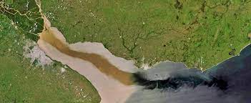
Hydrologic Micro Services (HMS) sediment module using the Sediment Yield’s Layered Vertically in Advection (SYLVIA v1.0) algorithm
Kar’retta Venable ^{𝑎}, Chris Knightes ^{𝑏}, John M. Johnston ^{𝑐}, Rajbir Parmar ^{𝑐}, Kurt Wolfe ^{𝑐}
^{𝑎} Oak Ridge Institute for Science Education (ORISE), U.S. Environmental Protection Agency (USEPA), Office of Research and Development, Center for Environmental Measurement and Modeling, Environmental Processes Division, Landscape and Aquatic Systems Modeling Branch, 960 College Station Road, Athens, GA 30605, USA, e-mail: venable.karretta@epa.gov
^{𝑏} USEPA Center for Environmental Measurement and Modeling, 27 Tarzwell Drive, Narragansett, RI 02882, USA, email: knightes.chris@epa.gov
^{𝑐} USEPA Center for Environmental Measurement and Modeling, 960 College Station Road, Athens, GA 30605, USA, email: johnston.johnm@epa.gov
Picture from: https://www.fondriest.com/environmental-measurements/parameters/hydrology/sediment-transport-deposition/
Notes:
https://www.fondriest.com/environmental-measurements/parameters/hydrology/sediment-transport-deposition/ → picture

Slide 2
Acknowledgements & Disclaimers
The authors would like to thank internal and external peer reviewers for their many useful comments on the technical documentation and software development. We would like to thank the HMS Team (USEPA) members for their contributions and insights to the development, calibration, and testing of the products.
This presentation has been reviewed by the US Environmental Protection Agency and approved for publication. Mention of trade names or commercial products does not constitute endorsement or recommendation for use by the U.S. Government. The views expressed in this article are those of the authors and do not necessarily reflect the views or policies of the U.S. EPA.

Slide 3
Overview
Justification & Purpose of Model
Advantages with HMS
Background
Demo
What’s Under the Hood?
Model Flowchart
Data Retrieval
Data Preprocessing
Derivation & Main

Slide 4
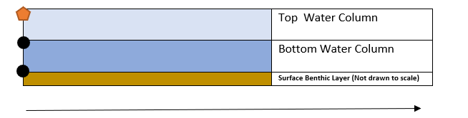
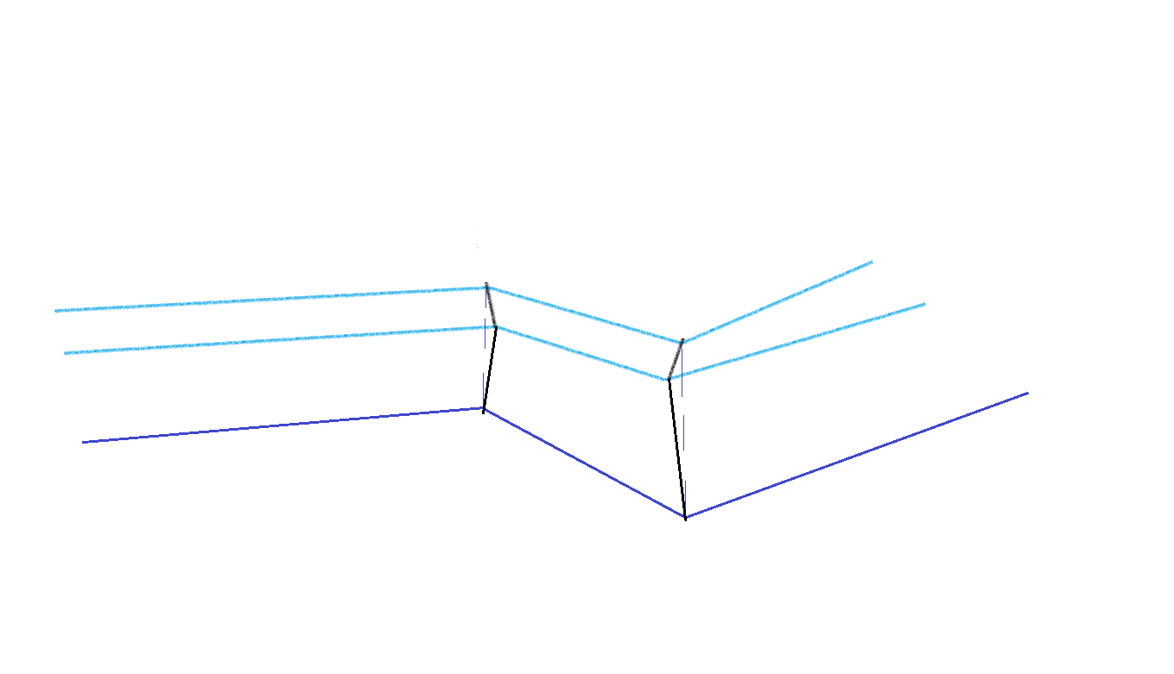
Justification & Purpose of Model
Limited data availability for total suspended solids (TSS) within aquatic ecosystems
Driven by land use changes and climate variability, the need for predictive sedimentation modeling in aquatic ecosystems is critical
SYLVIA v1.0, is a sedimentation model within the US EPA Hydrologic Micro Services (HMS), used to build user-defined workflows for decision support systems and comprehensive surface water modeling within the United States
The sedimentation model is a predictive tool which provides estimates for TSS using user-defined hydrodynamic characteristics of stream reaches and sediment parametrization to reflect the settling, resuspension, and depositional processes in the water column
With HMS, users are enabled with an abundance of environmental datasets and models to develop idealistic boundary conditions for predictive modeling of stream networks for assessing water quality and water quantity
Fig (1). Model design for Sylvia v 1.0. This initiation has used a garnet sand in the top layer and organic matter in the bottom water column layer and the surface benthic layer starting at the top of the layer depth. The horizontal line indicates streamflow velocity.
Fig (2). Model design for Sylvia v 1.0 displaying “rectangular” prism variations in channel depth, cross sectional area, and length through NHD+ COMIDs.

Slide 5
Justification & Purpose of Model
Limited data availability for total suspended solids (TSS) within aquatic ecosystems
Driven by land use changes and climate variability, the need for predictive sedimentation modeling in aquatic ecosystems is critical
SYLVIA v1.0, is a sedimentation model within the US EPA Hydrologic Micro Services (HMS), used to build user-defined workflows for decision support systems and comprehensive surface water modeling within the United States
The sedimentation model is a predictive tool which provides estimates for TSS using user-defined hydrodynamic characteristics of stream reaches and sediment parametrization to reflect the settling, resuspension, and depositional processes in the water column
With HMS, users are enabled with an abundance of environmental datasets and models to develop idealistic boundary conditions for predictive modeling of stream networks for assessing water quality and water quantity
Fig (1). Model design for Sylvia v 1.0. This initiation has used a garnet sand in the top layer and organic matter in the bottom water column layer and the surface benthic layer starting at the top of the layer depth. The horizontal line indicates streamflow velocity.
Fig (2). Model design for Sylvia v 1.0 displaying “rectangular” prism variations in channel depth, cross sectional area, and length through NHD+ COMIDs.

Slide 6
Justification & Purpose of Model
Limited data availability for total suspended solids (TSS) within aquatic ecosystems
Driven by land use changes and climate variability, the need for predictive sedimentation modeling in aquatic ecosystems is critical
SYLVIA v1.0, is a sedimentation model within the US EPA Hydrologic Micro Services (HMS), used to build user-defined workflows for decision support systems and comprehensive surface water modeling within the United States
The sedimentation model is a predictive tool which provides estimates for TSS using user-defined hydrodynamic characteristics of stream reaches and sediment parametrization to reflect the settling, resuspension, and depositional processes in the water column
With HMS, users are enabled with an abundance of environmental datasets and models to develop idealistic boundary conditions for predictive modeling of stream networks for assessing water quality and water quantity
Fig (1). Model design for Sylvia v 1.0. This initiation has used a garnet sand in the top layer and organic matter in the bottom water column layer and the surface benthic layer starting at the top of the layer depth. The horizontal line indicates streamflow velocity.
Fig (2). Model design for Sylvia v 1.0 displaying “rectangular” prism variations in channel depth, cross sectional area, and length through NHD+ COMIDs.

Slide 7
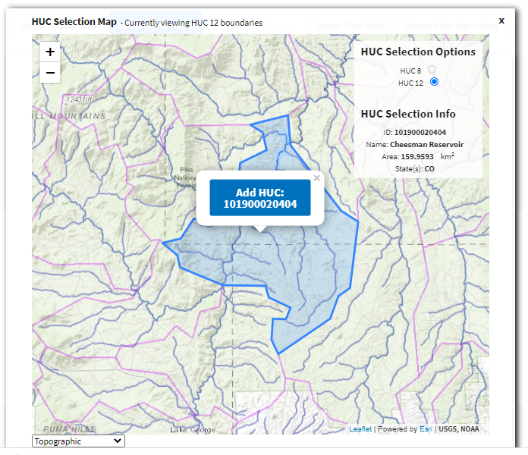

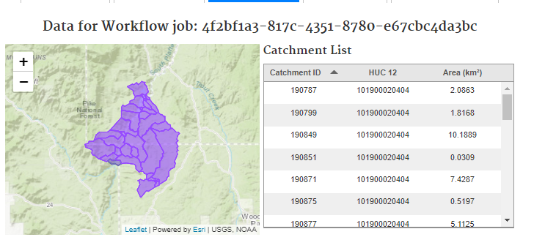
With USEPA Hydrologic Micro Services (HMS)
Advantages with HMS
Provides HUC12 watershed flow routing dynamics network
Flow dynamics are necessary to initialize model performance based on flow accumulations observed
Since continuous streamflow data is not available for long durations of time for every reach, HMS workflow assists in preprocessing data
Provides HUC12s catchment Common Identifier Code (COMIDs) and choice between streamflow driver algorithms and acquisition period over REST API

Slide 8

Background
SYLVIAv1.0’s inception is based upon the algorithms utilized in the USEPA Water Quality Analysis Simulation Program (WASP) (Wool, T. et al(2020, 2003); Di Toro et al., 1983) solids model designed for prediction in dynamic aquatic systems
Three layered box model, representative of either a reach network or partitioned individual COMID
User defines hydrodynamic model choice, sediment characteristics, and sediment transport options
Utilizes a dynamic compartmentalized, 1-D mass balance, advective transport (Reynolds Navier-Stokes based equations) settling, resuspension, and deposition for cohesive systems
The goal is to provide small scale incremental predictive estimates of in-stream TSS historically, present, and future for user driven-scenarios

Slide 9
Demo
(link to Github/video insert) will place a standing image for the case study analysis here
Notes:
Developing Short-Scale Demo Time frame in relation to the presentation. May omit and just place images from results. Demo will be based off Technical documentation jupyter notebook with data viewer. Will reflect Briar Creek case study

Slide 10


What’s Under the Hood?
Data Acquisition
Processing
Derivation

Slide 11

Model Construction Flowchart
SYLVIA
V(1.0.1)
GNU Fortan 11.2.0
Simply Fortran IDE 3.24
Build 3734
Main program
(.f08)
15 Subroutines (.f95),
1 Module
Jupyter Notebook Output Plotter
(Python 3.8.8)
User Defined
Sediment/Water Characteristics
Jupyter Notebook
HMS REST API
(Python 3.8.8)

Slide 12
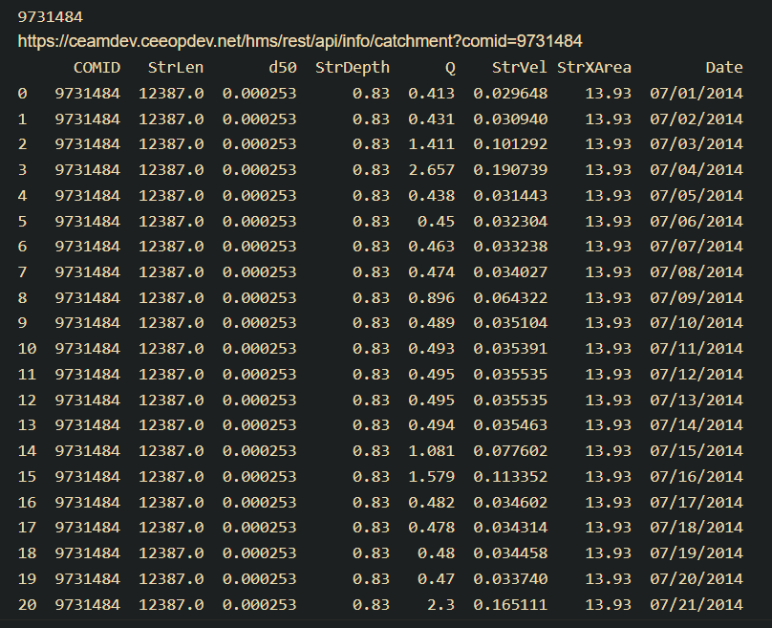
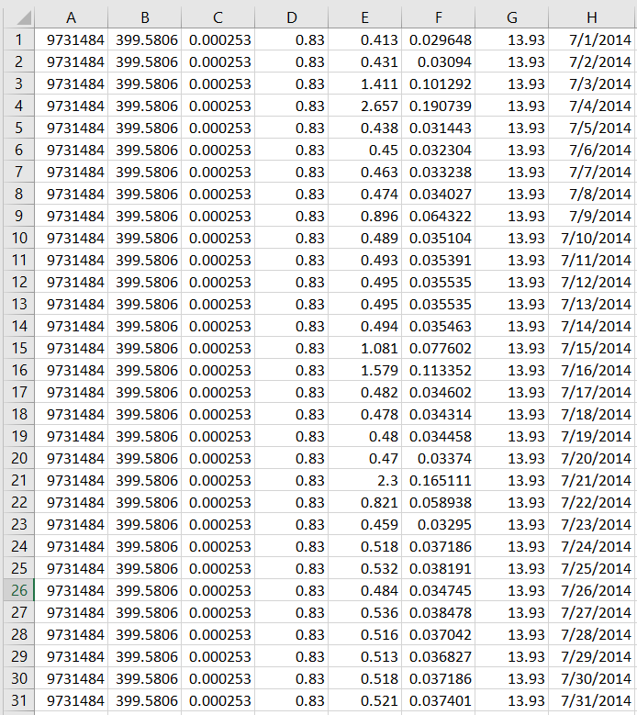
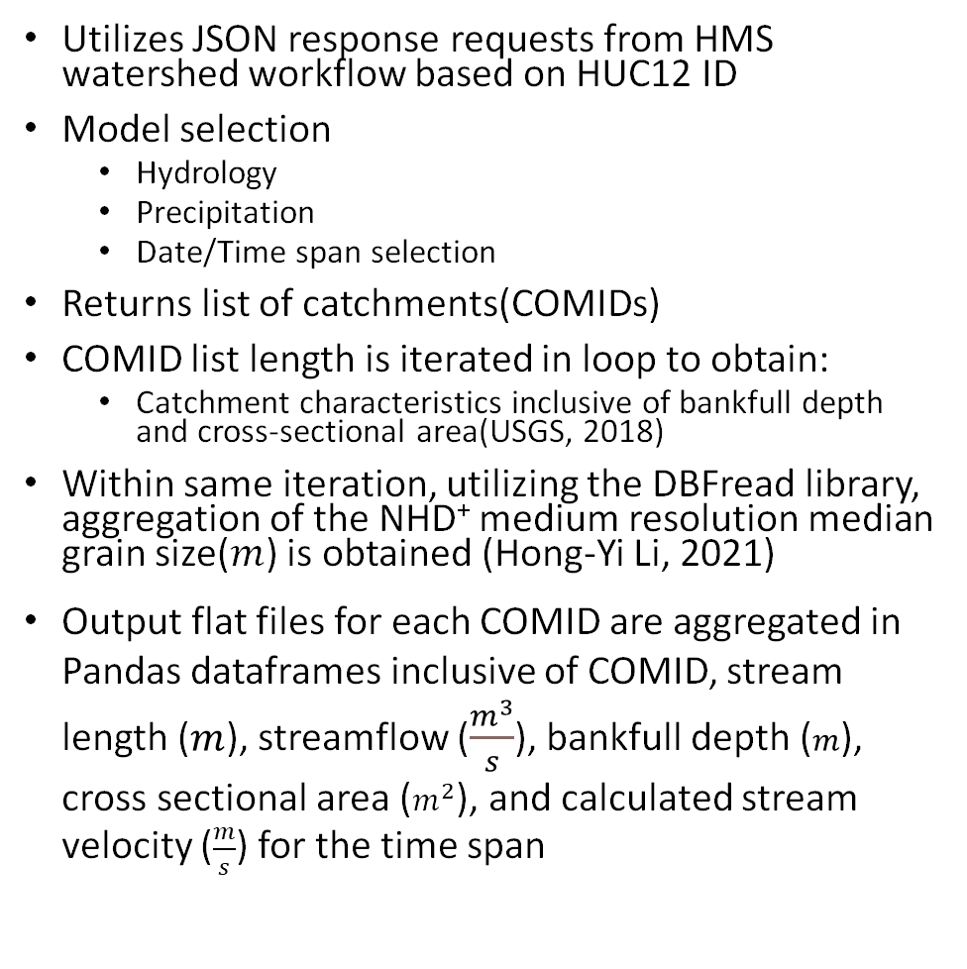
Model Construction - Data Acquisition
Acquisition
Utilizes JSON response requests from HMS watershed workflow based on HUC12 ID
Model selection
Hydrology
Precipitation
Date/Time span selection
Returns list of catchments(COMIDs)
COMID list length is iterated in loop to obtain:
Catchment characteristics inclusive of bankfull depth and cross-sectional area(USGS, 2018)
Within same iteration, utilizing the DBFread library, aggregation of the NHD⁺ medium resolution median grain size($m$) is obtained (Hong-Yi Li, 2021)
Output flat files for each COMID are aggregated in Pandas dataframes inclusive of COMID, stream length ($m$), streamflow ($\frac{m^{3}}{s}$), bankfull depth ($m$), cross sectional area ($m^{2}$), and calculated stream velocity ($\frac{m}{s}$) for the time span
Notes:
We can utilize two different schemas for file data retrieval 1) sequential aggregated by 1-day sort stream velocities with sequential comid network and full stream length 2) sequential daily aggregates of 1 comid which are portioned into equal sections summing the total length when = (stream length/# of records) in this Case it was 31 records

Slide 13
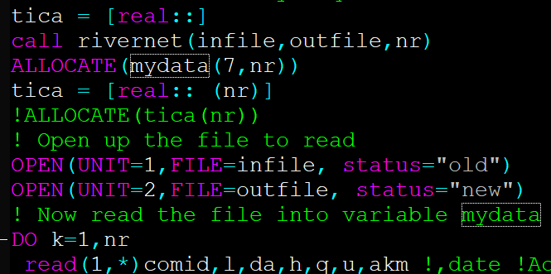
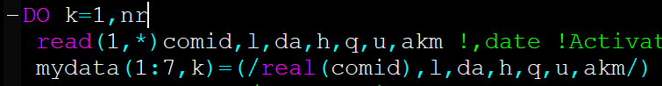
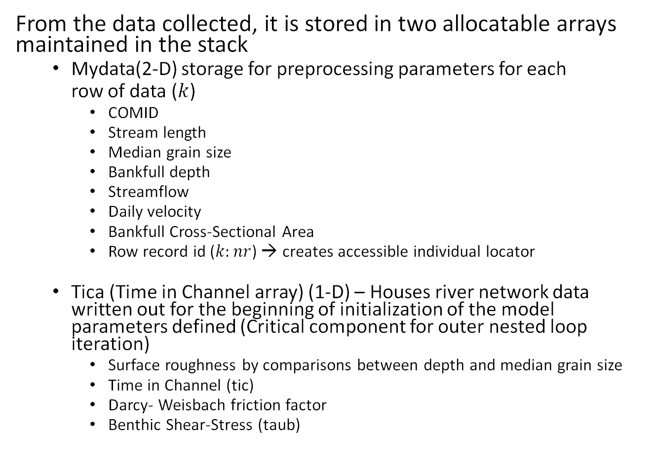
Model Construction - Data Preprocessing
Processing
From the data collected, it is stored in two allocatable arrays maintained in the stack
Mydata(2-D) storage for preprocessing parameters for each
row of data ($k$)
COMID
Stream length
Median grain size
Bankfull depth
Streamflow
Daily velocity
Bankfull Cross-Sectional Area
Row record id ($k:nr$) → creates accessible individual locator
Tica (Time in Channel array) (1-D) – Houses river network data written out for the beginning of initialization of the model parameters defined (Critical component for outer nested loop iteration)
Surface roughness by comparisons between depth and median grain size
Time in Channel (tic)
Darcy- Weisbach friction factor
Benthic Shear-Stress (taub)

Slide 14
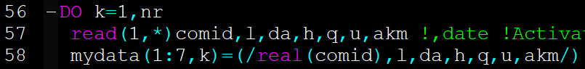
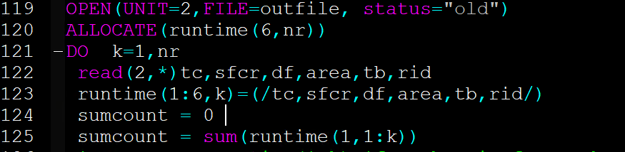
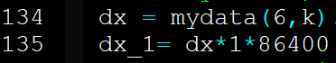
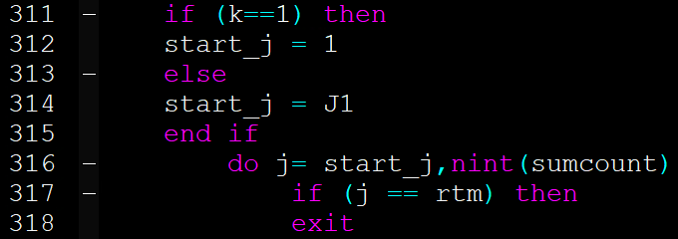
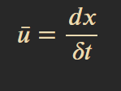
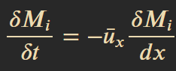
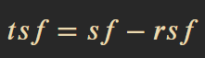
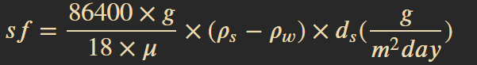
Model Construction - Derivation & Main
Derivation
Key Assumption (boundary conditions)
Determined by transport model
3 Options: (1) Legacy, (2) Descriptive, or (3) Van Rijn transport
Initialization of water characteristics based on user defined sediments for 3 layers (2 equally partitioned layers and a surface benthic layer)
Sediment characteristics include:
Water column segment
Particle type or density
Grain size → provides solids type classification
Resuspension velocity
Parametrization of critical shear stress, probability of deposition, and dimensionless exponent (changing from linear settling function)
Upon initialization (j=1, k=1)
Sumcount = sum(runtime(1,1:k)) within outer loop TIC
J1 = next start step iteration when TIC is exhausted for current segment
Pdx(Advection), Pdy (j-1) (Settling/Depositional)
Allocatable dynamic arrays utilizing move_alloc(memory allocation) to view j and j-1 for mass adjustment across time
Notes:
Inner Outer j & k loops

Slide 15
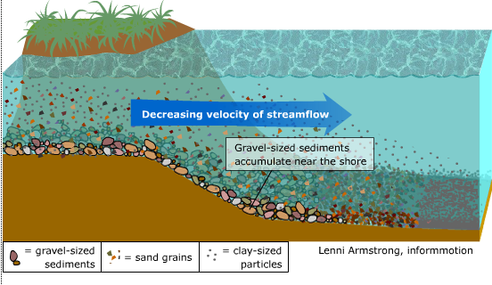
Conclusion
SYLVIAv1.0 provides six available output files(.csv): Global state file, x/y location relative to outlet, mass, concentration, mass adjustment, mass loss per each iteration time step and layer
Utilizes a dynamic compartmentalized, 1-D mass balance, advective transport (Reynolds & Navier-Stokes based equations) settling, resuspension, and deposition for cohesive systems
The goal is to provide small scale incremental predictive estimates of in-stream TSS historically, present, and future for user driven-scenarios for the public
http://thebritishgeographer.weebly.com/river-processes.html
Notes:
http://thebritishgeographer.weebly.com/river-processes.html

Slide 16

Future Work
Validation of performance
Utilize kinematic wave (dynamic depth)
Include Streamcat lithology and STATSGO regional percentages for development of cumulative distributions for TSS
Create GUI/Interface
Include erosion and non-cohesive suspension

Slide 17
References
Allen, G. H., & Pavelsky, T. M. (2015). Patterns of river width and surface area revealed by the satellite-derived North American River Width data set. Geophysical Research Letters, 42(2), 395-402. https://doi.org/10.1002/2014gl062764
Boulton, A. J., Stuart Findlay, Pierre Marmonier, Emily H. Stanley, and H. Maurice Valett (1998). The functional significance of the hyporheic zone in streams and rivers. Annual Review of Ecological Systems, 29, 59-81. https://doi.org/0066-4162/98
Ebert, D., Wickham, J., Neale, A., & Mehaffey, M. (2021). A landscape assessment and associated dataset of stream confluences for the conterminous U.S. J Am Water Resour Assoc, 57(2), 315-327. https://doi.org/10.1111/1752-1688.12899
Huettel, M., Roy,Hans , Precht , Elimar & Ehrenhauss, Sandra (2003). Hydrodynamical impact on biogeochemical processes in aquatic sediments. Hydrobiologia, 494, 231-236.
Li, H.-Y., Abeshu, Guta, Zhu, Zhenduo, Tan, Zeli, & Leung, L. Ruby (2021). A national map of riverine median bed-material particle size over CONUS (DE-AC05-76RLO1830; [dbf]. https://doi.org/10.5281/zenodo.4921987
McKay, L., Bondelid, T., Dewald, T., Johnston, J., Moore, R., and Rea, A. (2019). NHDPlusV2 User Guide.
Packman, A. M. S. (2003). Relative roles of stream flow and sedimentary conditions in controlling hyporheic exchange. Hydrobiologia, 494, 291-297.
Survey, U. S. G. (2018). NHDPlus 2.1 BANKFULL_CONUS, BANKFULL_WIDTH, BANKFULL_DEPTH. https://doi.org/10.5066/P9PA63SM
Wool, T. "Wasp the Solids Module." 2017, p. 19.
Wool, T., Ambrose, R. B., Jr., Martin, J. L., & Comer, A. (2020). WASP 8: The Next Generation in the 50-year Evolution of USEPA's Water Quality Model. Water (Basel), 12(5), 1398. https://doi.org/10.3390/w12051398

Slide 18

Thank You !!

Slide 19
Hydrologic Micro Services (HMS) sediment module using the Sediment Yield’s Layered Vertically in Advection (SYLVIA v1.0) algorithm
Kar’retta Venable ^{𝑎}, Chris Knightes ^{𝑏}, John M. Johnston ^{𝑐}, Rajbir Parmar ^{𝑐}, Kurt Wolfe ^{𝑐}
^{𝑎} Oak Ridge Institute for Science Education (ORISE), U.S. Environmental Protection Agency (USEPA), Office of Research and Development, Center for Environmental Measurement and Modeling, Environmental Processes Division, Landscape and Aquatic Systems Modeling Branch, 960 College Station Road, Athens, GA 30605, USA, e-mail: venable.karretta@epa.gov
^{𝑏} USEPA Center for Environmental Measurement and Modeling, 27 Tarzwell Drive, Narragansett, RI 02882, USA, email: knightes.chris@epa.gov
^{𝑐} USEPA Center for Environmental Measurement and Modeling, 960 College Station Road, Athens, GA 30605, USA, email: johnston.johnm@epa.gov
Picture from: https://www.fondriest.com/environmental-measurements/parameters/hydrology/sediment-transport-deposition/
Notes:
https://www.fondriest.com/environmental-measurements/parameters/hydrology/sediment-transport-deposition/ → picture

